Slide 1



Seventh Generation
Inc.
To Transform the World into a Healthy, Sustainable, and Equitable Place for the Next Seven Generations.

Slide 2

Full Circle Product Design
More recycled and recyclable packaging that doesn't just become more waste,
To nurture natural resources
From biodegradable ingredients that come from plants
Products work in harmony with the planet
build a healthier future for all.

Slide 3


Everyday messes meet their match
All purpose cleaners are safe for cleaning around kids and pets. Designed to cut grease and grime everywhere in your home. Our botanical disinfectants kill 99.9% of household germs on hard non-porous surfaces with no rinse required.

Slide 4



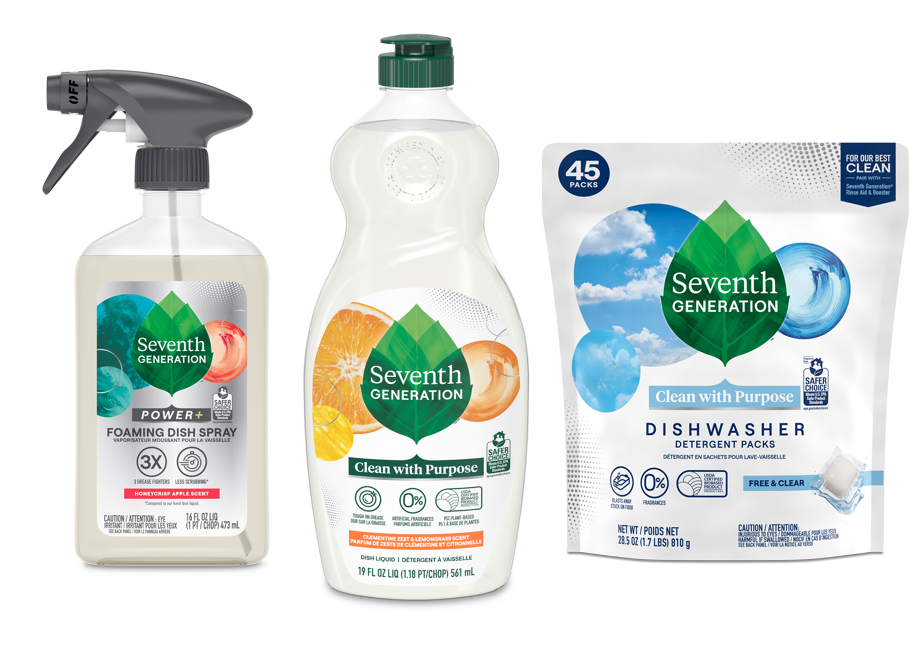
Tackle Dishes with Confidence
EPA Safer Choice certified dish products are safe for you and your family. Make sink time more enjoyable with scents from 100% essential oils and botanical ingredients. Clean up is a breeze with biobased and mineral based auto dish packs.

Slide 5
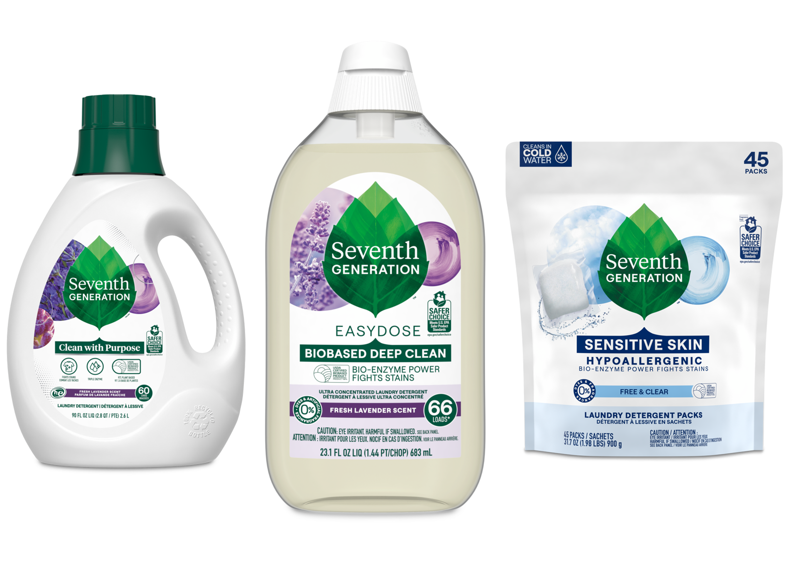

Bio based Stain Fighters
Powerful bio-enzymes lift away stubborn stains with EPA Safer Choice Certified formulas. Choose fragrance free for sensitive skin or indulge in fragrances from 100% essential oils and botanical ingredients. Clean laundry starts here.

Slide 6

DESKTOP SOFTWARE
It Is Easily Available In The Virtual Markets And In The Goods One Too

Slide 7
THANKS!
Do you have any questions?
GigaN.igga2sc@gmail.com
+91 620 421 838

